Slide 1
Cataloging and Indexing

Slide 2
Introduction
Indexing: Indexing is the process of converting an item (such as a document or data entry) into a searchable data structure.
  This process can be done manually by a person or automatically by software, creating the basis for direct search of items in the Document Database or indirect search via Index Files.
Some systems transform items into a concept-based representation rather than a direct textual representation.

Slide 3
Introduction
Information extraction is closely associated with the indexing process.
Goal: To extract specific information to be normalized and entered into a structured database (DBMS)
  Normalization: The extracted information is modified to fit into a structured database management system (DBMS).
Information extraction differs because it focuses on very specific concepts and contains a transformation process that modifies the extracted information into a form compatible with the end structured database. This process is referred as Automatic file Build.

Slide 4
History of Indexing
Indexing (originally called Cataloging) is the oldest technique for identifying the contents of items to assist in their retrieval.
Encouraging users to access item contents in an efficient way has always been the primary objective of indexing.
In pre-19th Century cataloging methods evolved slowly. Early cataloging was straightforward, focusing on organizing information with basic bibliographic details.

Slide 5
History of Indexing
In 19th Century the system became more sophisticated with the introduction of hierarchical methods like the Dewey Decimal System, which organizes subjects into a hierarchical structure.
In 1960s the Library of Congress began exploring computerization for cataloging. The MARC (MAchine Readable Cataloging) standard was developed to create a standardized format for bibliographic records, facilitating the sharing and electronic management of catalog data.
In 1965 DIALOG System was Developed by Lockheed for NASA and commercialized in 1978, DIALOG was one of the earliest commercial indexing systems, offering a vast number of databases to users globally.

Slide 6
Objectives of Indexing
The evolution of Information Retrieval (IR) systems has significantly impacted the objectives and methods of indexing.
When an item's entire text becomes searchable, objectives that were previously used to establish manual indexing rules are no longer applicable.
Total document indexing is a new type of indexing made possible by the full text searchable data format for Document File elements.
  [With the advent of digital documents, systems can now index and search the entire text of a document. This method, known as total document indexing, treats all words in a document as potential index terms.]

Slide 7
Objectives of Indexing
The process of item normalization involves converting all possible words into processing tokens—units used to represent the document’s content in a searchable format.
Modern systems have the ability to automatically weigh the processing tokens based on their importance.
Despite full-text search capabilities, manual indexing still has value.
  While automated systems can search all words, manual indexing involves selecting and abstracting key concepts, adding value by providing context and relevance that automated systems might miss.

Slide 8
Objectives of Indexing
Two types of index files:
  Public Index Files: These are broad and include more general terms applicable to a wide audience. They enhance search recall by covering a wide range of concepts.
  Private Index Files: These are user-specific and contain more focused, relevant terms based on individual needs. They improve search precision by filtering information to match the user’s specific interests.

Slide 9
Objectives of Indexing
Electronic indexes support additional functionalities like ranking search results by relevance and clustering items by concepts.
This helps users find the most relevant information more efficiently, similar to browsing in a physical library.
The system adapts to user needs by combining public and private indexing methods, allowing users to customize their searches and manage information more effectively.

Slide 10
Indexing Process
When an organization with multiple indexers is setting up public or private indexes, some procedural decisions about how to build the index terms are required.
  This help the indexers and end users know what to expect in the index file.
Two key procedural decisions are:
  scope of the indexing: The scope of indexing refers to the level of detail and breadth of coverage that the subject index will include.
  Linking Index Terms: Linking index terms involves connecting related terms or concepts within a single index to facilitate better navigation and understanding of the subject matter. This decision determines how index terms will be organized and interrelated.

Slide 11
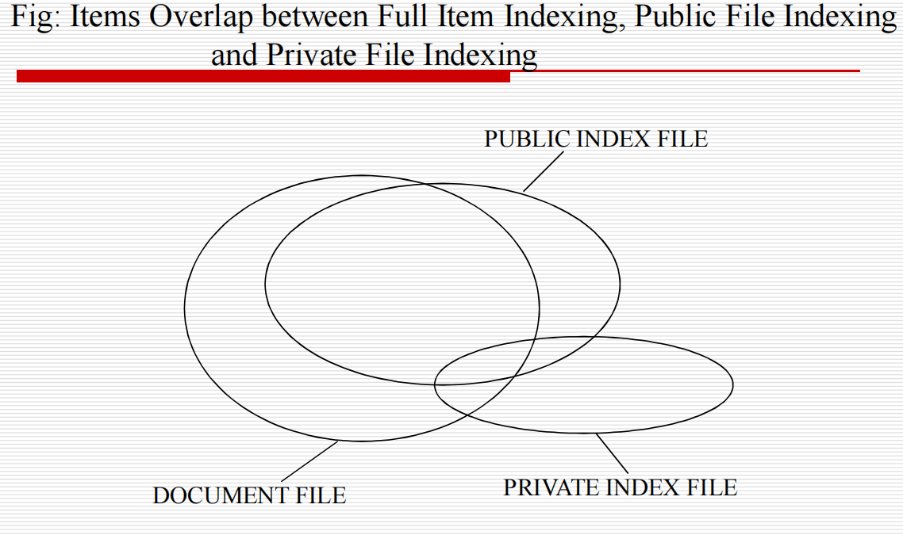
Indexing Process

Slide 12
Scope of Indexing
Finding the bibliographic phrases that accurately and consistently describe the ideas in an item is a very challenging task when done by hand. Interaction between the author and the indexer can lead to issues.
  Authors use their own specialized terms and language based on their field of expertise. For instance, a medical researcher might use technical terms specific to their field that are not widely known outside of it.
  Indexers may have a different set of terms or less familiarity with the author’s specific vocabulary. If an indexer doesn’t understand or recognize the author’s specialized terminology, they might misinterpret the content or choose less accurate index terms.
  For example:
    Author uses the term “myocardial infarction” to describe a heart attack.
    Indexer might not be familiar with this term and choose a more general term like “heart disease” instead. This could lead to less precise indexing of the document.
  Authors are often experts in their subject matter, and their writing might include complex, nuanced discussions that reflect deep knowledge.
  Indexers might not have the same level of expertise in the specific subject area. They might not fully grasp the significance or the context of certain concepts, which can affect the accuracy and depth of the indexing.
  Indexers need to decide when to stop adding terms to the index.
    This decision involves balancing thoroughness with practical constraints like time and cost.

Slide 13
Scope of Indexing
Selecting the appropriate indexing level for an item's concepts depends on two criteria:
Exhaustivity: This relates to the extent to which certain concepts within the document are fully indexed.
  For example, in a lengthy document on microprocessors, if only a small section discusses a specific aspect like “on-board caches,” the indexer must decide if this should be included or not.
Specificity: This refers to how detailed or precise the index terms are.
  For instance, deciding whether to use “processor,” “microcomputer,” or a specific model like “Pentium” depends on how specific the index should be.
  High specificity involves using very precise terms, while low specificity uses more general terms.

Slide 14
Scope of Indexing
Low Exhaustivity and Specificity:If only the most important concepts are indexed with general terms, it simplifies the indexing process and reduces costs but may lead to less detailed searches and lower precision in retrieving specific information.
High Exhaustivity and Specificity: This approach involves indexing nearly every relevant concept with detailed terms, making the index more comprehensive. For example, a detailed index (for the paragraph in the Kowalski text book) might include terms like “indexing,” “indexer knowledge,” “exhaustivity,” and “specificity” for a given document.

Slide 15
Scope of Indexing
Another decision on indexing is what portions of an item should be indexed.
  The simplest case is to limit the indexing to the Title or Title and Abstract zones.
  This method reduces the cost and effort but might miss important details, affecting the index’s effectiveness.
Weighting of index terms is not common in manual indexing systems.
Weighting of index terms involves assigning a level of importance to different terms based on how much they are discussed in a document.

Slide 16
Scope of Indexing
Example for Weighting of index terms :
Imagine you are indexing a research paper on "Artificial Intelligence in Healthcare". The paper covers various topics such as:
  Machine Learning Algorithms
  Healthcare Data Security
  Medical Imaging Techniques
  Patient Privacy Issues
Without Weighting:
  Artificial Intelligence
  Healthcare Data Security
  Medical Imaging Techniques
  Patient Privacy Issues
  In this scenario, each term is treated equally, regardless of how extensively or prominently it is covered in the document. This means that if the paper spends a lot of time on "Machine Learning Algorithms" but only briefly mentions "Patient Privacy Issues," both terms will be listed in the index with equal prominence.

Slide 17
Scope of Indexing
With Weighting:
  When using weighting, you assign levels of importance to index terms based on their prominence in the paper. For instance:
  Machine Learning Algorithms (Weight: 5)
  Healthcare Data Security (Weight: 3)
  Medical Imaging Techniques (Weight: 2)
  Patient Privacy Issues (Weight: 1)
Here’s how you might determine these weights:
  Machine Learning Algorithms (Weight: 5): The paper extensively discusses various algorithms, providing detailed analysis and numerous examples. This term is given a high weight because it’s a central topic.
  Healthcare Data Security (Weight: 3): There is significant discussion on this topic, but it's not as central as machine learning. It’s important but secondary.
  Medical Imaging Techniques (Weight: 2): This topic is mentioned, but only briefly. It’s relevant but not a major focus.
  Patient Privacy Issues (Weight: 1): This is a minor point discussed briefly. It’s the least emphasized topic in the paper.
Benefits of Weighting:
  Improved Precision: Users searching for in-depth information on "Machine Learning Algorithms" will easily find the relevant sections because this term is given a higher weight.
  Enhanced Relevance: Weighting helps in presenting the most relevant terms more prominently, making searches more effective.
  Efficient Retrieval: Users can quickly locate major themes and important sections of the document based on the weighted index terms.

Slide 18
Scope of Indexing
Implementing weighting requires additional effort in terms of assigning and managing weights, which complicates the indexing process.
Storing and retrieving weighted terms requires more sophisticated data structures, increasing the complexity of the indexing system.

Slide 19
Precoordination and Linkages
Linkages refer to connections made between index terms to show relationships or attributes.
  For example, if you're indexing a document about oil drilling in Mexico, linkages might connect terms like "Mexico" and "oil drilling.“
When related terms are linked together at index creation time then it is called precoordination.
  This means the relationships between terms are set in advance.
When index terms are not coordinated at index time, the coordination occurs at search time. This is called postcoordination, that is coordinating terms after (post) the indexing process.
  Postcoordination is implemented by “AND”ing index terms together, which only finds indexes that have all of the search term

Slide 20
Precoordination and Linkages
Factors (elements) that must be determined in the linkage process are:
  Number of Terms: Determines how many terms can be linked together.
  Any Ordering Constraints on the linked terms: Defines if the order of terms matters. For instance, if the sequence "Mexico – oil drilling" is different from "oil drilling – Mexico.“
  Any Additional Descriptors are associated with index terms: Additional information that describes the role of each term.
    Example: Suppose you are indexing a document about "CITGO’s oil drilling in Mexico affecting local communities." Here’s how you could use descriptors:
      "CITGO (Source) – oil drilling (Activity) – Mexico (Location).“
    The descriptors clarify the role of each term, allowing users to search for documents where CITGO is performing oil drilling activities in Mexico.

Slide 21
Precoordination and Linkages
When multiple terms are being used, the possibility exists to have relationships between the terms.
Each term has to be qualified with one of these three categories and linked to another term to illustrate how the relationships between the terms describe a single semantic concept.
  order of the terms
  Positional Roles
  Modifiers

Slide 22
Precoordination and Linkages
  order of the terms: When linking terms, ordering can be used to provide additional context.
    For instance, "CITGO – oil drilling – Mexico" might imply that CITGO is drilling oil in Mexico.
  Positional Roles refer to a technique where the position of terms in an index entry implicitly defines their roles or relationships. The position of each term within a sequence indicates its function or significance in relation to other terms.
  In a sequence like "U.S. – oil refineries – Peru," each term occupies a specific position:
    "U.S." is in the first position.
    "oil refineries" is in the second position.
    "Peru" is in the third position.
    The roles are assigned based on the predefined positions. For instance, the first position might always represent the source, the second position the activity, and the third position the location.
    If the sequence has a fixed number of positions and you need to include additional details, you may face limitations. For instance, if you want to add more roles, such as the impact or timeframe, the fixed positions may not accommodate these additional details without causing ambiguity.

Slide 23
Precoordination and Linkages
Modifiers: Instead of using positional roles, modifiers allow for a more flexible approach. One entry could list multiple countries with corresponding modifiers, reducing the need for multiple separate entries.
Example: Suppose you are indexing a document about "U.S. introducing oil refineries into Peru, Bolivia, and Argentina.“
  Using positional roles, you would have multiple separate entries to cover each location:
    "U.S. – oil refineries – Peru”
    "U.S. – oil refineries – Bolivia"
    "U.S. – oil refineries – Argentina“
  With modifiers, you can create a single entry that lists all the countries with their respective roles:
    "U.S. – oil refineries – Peru (affected country) – Bolivia (affected country) – Argentina (affected country)“
  Here, "affected country" is the modifier applied to each location to indicate their role in the context of the oil refineries.
  If the document also mentions the impact of the oil refineries, you could add:
    “U.S. – oil refineries – Peru (affected country, economic impact) – Bolivia (affected country, economic impact) – Argentina (affected country, economic impact)"

Slide 24
AUTOMATIC INDEXING
Automatic indexing refers to a system’s ability to automatically select index terms for an item (e.g., a document) without human intervention.
This contrasts with human indexing, where a person manually determines the index terms based on their understanding.
Simple Indexing uses every word in the document as an index term (total document indexing).
Complex Indexing is required when the objective is to imitate a human indexer and determine a limited number of index terms for the major concepts in the item.

Slide 25
AUTOMATIC INDEXING
Advantages of Automatic Indexing:
  Cost Efficiency: After initial hardware costs, the ongoing costs are minimal compared to salaries for human indexers.
  Processing Speed: Automatic indexing is much faster, taking only a few seconds compared to the several minutes a human indexer might need for each document.
  Consistency: Algorithms used in automatic indexing provide consistent results, whereas human indexers may produce varying results for the same document. For instance, in TREC-2 experiments, different judges had about a 20% discrepancy in indexing the same documents.

Slide 26
AUTOMATIC INDEXING
Advantage of Human Indexing: The ability to determine concept abstraction and judge the value of a concept.
  Concept Abstraction: Understanding and expressing a document's fundamental ideas or themes outside of its actual text is known as concept abstraction.
    Identify Broader Themes: For example, a human indexer can recognize that a document discussing various aspects of "climate change" might be relevant to a broader category of "environmental issues.“
    Contextual Understanding: They can interpret the context in which terms are used. For example, the term "bank" could refer to a financial institution or the side of a river, and human indexers can use contextual clues to determine which meaning is relevant.
  Judgment of Concept Value: Judgment of concept value involves assessing the importance or relevance of different concepts within a document.
    Human indexers can prioritize concepts based on their relevance to the intended audience or user needs. For instance, in a medical document, they might highlight terms related to treatment over those related to general symptoms.

Slide 27
AUTOMATIC INDEXING
Indexes resulting from automated indexing fall into two classes:
  Weighted: Assigns weights to index terms based on their frequency in the document, reflecting their importance. Higher weights indicate a stronger representation of a concept. This method often uses normalized values and allows for ranking search results based on their relevance.
  Unweighted: Only records the presence (and sometimes location) of index terms without differentiating their significance. Early systems often used this method, and all indexed items are treated equally in searches.
  Concept Indexing: Instead of directly indexing the original text, this method maps the document into a different representation based on concepts. The final index values are derived from these concepts.

Slide 28
AUTOMATIC INDEXING
Research and Theoretical Background:
  Luhn’s Resolving Power: Luhn suggested that the importance of a term is proportional to its frequency in the document.
  Distribution of Terms: Studies by Brookstein, Klein, and Raita found that important terms often cluster together rather than being evenly distributed.

Slide 29
AUTOMATIC INDEXING --
Indexing by Term
There are two major techniques for creation of the index:
  Statistical ‰
  Natural language
Statistical techniques:
  These are classified as statistical because their calculation of weights use statistical information such as the frequency of occurrence of words and their distributions in the searchable databases.
  There are two main types mentioned:
    vector models and probabilistic models with a special case being Bayesian models.

Slide 30
Indexing by Term
Vector Models: Vectorized information systems are those that use vectors (arrays of numbers) to represent documents and queries.
  Each document is represented as a vector in a high-dimensional space.
  Each dimension of the vector corresponds to a unique term (or token) in the database.
  The value in each dimension (or position) of the vector indicates the weight of the term in that document.
  A weight of zero means the term does not appear in the document.
  Queries are also converted into vectors, and the system calculates the similarity between the query vector and document vectors, often using distance measures (e.g., cosine similarity).

Slide 31
Indexing by Term
Bayesian model: This approach could be applied as part of index term weighting, but usually is applied as part of retrieval process by calculating relationship between an item and specific query.
  A Bayesian network is a directed acyclic graph in which each node represents a random variable and the arcs between the nodes represent a probabilistic dependence between the node and its parents

Slide 32
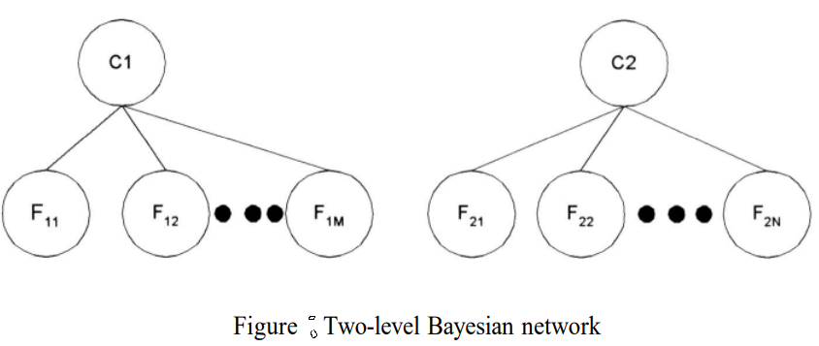
Bayesian model
The following figure shows the basic weighting approach for index terms or associations between query terms and index terms.
The nodes C₁ and C₂ represent “the item contains concept C_{i}” and the F nodes represent “the item has feature (e.g., words) F_{iJ}.”
The network could also be interpreted as C representing concepts in a query and F representing concepts in an item. The goal is to calculate the probability of C_{i} given F_{ij}.

Slide 33
Bayesian model
To calculate the probability of C_{i} given F_{ij}, two sets of probabilities are needed:
  Prior Probability P(C_{i}): The probability that an item is relevant to the concept C before considering any features.
  Conditional Probability P(F_{ij}∣C_{i}): The probability that a feature F_{ij}​ where j=1,m is present given that the item is relevant to the concept C.
The automatic indexing task is to calculate the posterior probability P(C_{i}∣F_{i1}….. F_{im}) -- [the probability of C_{i} given F_{iJ}.“] [the probability that the item contains concept C_{i} given the presence of features F_{iJ}. ]

Slide 34

Bayesian model
The posterior probability P(C_{i}∣F_{i1}….., F_{im}), where F represents the features, can be computed using Bayes' theorem:
  P(C_{i}∣F_{i1}….. F_{im}) = P(F_{i1}….., F_{im} ∣C_{i})⋅P(C_{i})\P(F_{i1}….., F_{im})
If you want to rank items based on their posterior probabilities, you can simplify the calculation using a linear decision rule.
Define an indicator variable I(F_{ik}) ​ which is 1 if feature F_{ik}​ is present in the item and 0 otherwise. Let w_{i}​ be the coefficient (or weight) for feature F_{ik}​. The ranking function can be:

Slide 35
Bayesian model
Here:
  g is a score based on the features.
  w_{i}​ represents the importance of feature F_{i}​.
A careful choice of w produces a ranking in decreasing order that is equivalent to the order produced by the posterior probabilities.

Slide 36
Bayesian model ---
Example
If want to rank documents based on their relevance to a concept, say "machine learning."
Each document has features like keywords. Here’s how you might approach this:
Prior Probability P(C):
  Suppose C represents the concept "machine learning.“
  If you have data showing that 30% of documents are about machine learning, then P(C)=0.3.

Slide 37
Bayesian model ---
Example
Conditional Probability P(F_{i}∣C):
  Suppose F₁​ is the feature "neural networks" and F₂​ is the feature "data science.
  "If 80% of documents about machine learning contain "neural networks," then P(F₁∣C)=0.8.
  If 50% of documents about machine learning contain "data science," then P(F₂∣C)=0.5.
Probability of Features P(F):
  This is the probability of seeing features F₁​ and F₂​ in any document, regardless of relevance to the concept. Assume:
    P(F₁​)=0.4 (probability of "neural networks" appearing in a document).
    P(F₂)=0.6(probability of "data science" appearing in a document).

Slide 38
Example
For a document containing both features "neural networks" and "data science," the goal is to estimate the probability that it is relevant to "machine learning.“
Using Bayes' theorem, the posterior probability P(C_{i}∣F_{i1}….. F_{im}) where F includes both features can be calculated as:
    P(C_{i}∣F_{i1}….. F_{im}) = P(F_{i1}….., F_{im} ∣C_{i})⋅P(C_{i})\P(F_{i1}….., F_{im})
Joint Probability of Features Given Concept P(F∣C) :
  Assuming the features are independent given the concept, P(F_{i1}….., F_{im} ∣C_{i}) can be computed as: P(F_{i1}….., F_{im} ∣C_{i}) =P(F₁∣C)×P(F₂∣C)=0.8×0.5=0.4

Slide 39
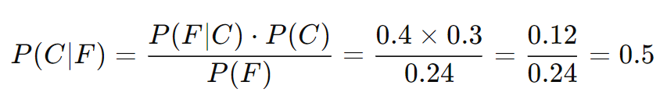
Example
Probability of Features P(F):
  P(F) is the probability of both features appearing in a document:
  P(F)=P(F₁)×P(F₂)=0.4×0.6=0.24
  Posterior Probability Calculation:
  Thus, given the features, the probability that the document is about "machine learning" is 0.5.

Slide 40
Example
Linear Decision Rule for Ranking:
  To rank documents, you use a linear decision rule:
Assume:
  w1 ​ (weight for "neural networks") = 2
  w2 ​ (weight for "data science") = 1
For a document containing both features: g=(2×1)+(1×1)=2+1=3
Documents are then ranked based on the value of g. The higher the g value, the more relevant the document is to the concept "machine learning."

Slide 41
AUTOMATIC INDEXING --
Indexing by Term
Natural Language Processing:
  Instead of using traditional methods to index documents (which might be simpler keyword-based approaches), this method employs NLP techniques to better understand and categorize the content of documents.
    Using NLP, a system can understand not just the words but also their meanings, how they relate to each other, and their broader context.

Slide 42
Natural Language Processing
The DR-LINK (Document Retrieval through Linguistic Knowledge) system is a specific NLP system processes items at the morphological, lexical, semantic, syntactic, and discourse levels:
  Morphological Level: Examines the structure and formation of words
    Example: The word "unhappiness" is broken down into "un-" (prefix), "happy" (root), and "-ness" (suffix). The system understands it means "not happy."
  Lexical Level: Focuses on the words themselves, including their meanings and relationships.
    Example: In the phrase "solar panels," the system recognizes "solar" as related to the sun and "panels" as objects that capture sunlight.

Slide 43
Natural Language Processing
  Semantic Level: Understands the meaning of the words and phrases in context.
    Example: The sentence "The company will launch a new product next year" is understood to mean that an event (the launch) will happen in the future.
  Syntactic Level: Analyzes the grammatical structure of sentences.
    Example: The sentence "The CEO announced the merger" is parsed to identify that "CEO" is the subject, "announced" is the verb, and "the merger" is the object.
  Discourse Level: Looks at larger text structures and how sentences and phrases work together to convey meaning.
    Example: In a document discussing multiple events, such as "The company was sold last year, and now it is expanding," the system can understand the chronological sequence and the relationship between these events.

Slide 44
Natural Language Processing
Each level uses information from the previous level to perform its additional analysis.
  Example: understanding that "unhappiness" is derived from "happy" helps in recognizing that it means "not happy," which contributes to grasping the overall sentiment of a sentence.
The discourse level is abstracting information beyond the sentence level and can determine abstract concepts using predefined models of event relationships.
  Beyond Sentence Level: This approach examines how sentences relate to each other within a larger context. It looks at how ideas are connected and how the text flows from one point to another.
    Example:
      "The city council approved the new park project last week.“
      "Construction is expected to start next month.“
      "The community is excited about the new recreational space.“
    The discourse level looks at how these sentences connect to tell a story about a new park project. It understands that:
      Sentence 2 ("Construction is expected to start next month") is a direct consequence of the decision in Sentence 1 ("The city council approved the new park project last week").
      Sentence 3 ("The community is excited about the new recreational space") reflects the community's reaction to the news from Sentence 1, indicating a positive reception to the project.
  Abstract Concepts: These are ideas or relationships that are not explicitly mentioned but are implied or understood through context. For example, understanding a text about "a company's future plans" involves grasping concepts like "strategic vision" and "future projections," even if they are not directly stated.

Slide 45
Natural Language Processing
Normal automatic indexing does a poor job at identifying and extracting “verbs” and relationships between objects based verbs.

Slide 46
Indexing by Concept
The core idea behind concept indexing is that the same underlying idea can be expressed using different words, phrases, or terms.
  In conventional information retrieval, each term or word is treated separately.
    To address this, techniques like thesauri or query expansion are used.
  Traditional term-based indexing might struggle to retrieve relevant information if the exact terms used in a query are not present in the documents.

Slide 47
Indexing by Concept
Concept indexing determines a canonical set of concepts based upon a test set of terms and uses them as a basis for indexing all items.
  This is also called Latent Semantic Indexing because it is indexing the latent semantic information in items.
The determined set of concepts does not have a label associated with each concept (i.e., a word or set of words that can be used to describe it), but is a mathematical representation (e.g., a vector).

Slide 48
Indexing by Concept
-- Example
Documents:
  Document 1: "The impact of climate change on polar bears."
  Document 2: "Renewable energy solutions for combating global warming."
  Document 3: "Effects of global warming on coastal regions."
Test Set of Terms:
  Terms: "Climate Change," "Global Warming," "Renewable Energy," "Polar Bears," "Coastal Regions”

Slide 49

Indexing by Concept
-- Example
To determine set of canonical concepts first construct Term-document matrix and apply Singular Value Decomposition (SVD)
  After applying SVD, the concepts are represented as vectors in a reduced-dimensional space. Each vector captures how strongly a concept is associated with various terms and documents.
  For Concept 1 Vector might have high values for terms like "Climate," "Change," "Impact" and low or zero values for unrelated terms.
  For Concept 2 Vector might have high values for terms like "Energy," "Solutions," "Renewable" and low values for unrelated terms.

Slide 50
Indexing by Concept
-- Example
Query: "climate change effects" will be transformed into a vector that represents the concept of "Climate Change Impact."
  Query Vector: [0.85, 0.75, 0.05, 0.0, 0.35, 0.0]
Compare this query vector with the concept vectors for documents to find relevant matches.
  Calculate how similar the query vector is to each document’s concept vector. Documents with high similarity scores are considered relevant.

Slide 51
Indexing by Concept
An example of a system that uses concept indexing is the MatchPlus system developed by HNC Inc.
The MatchPlus system uses neural networks to facilitate machine learning of concept/word relationships and sensitivity to similarity of use
  The system aims to analyze and utilize word relationships (like synonyms) and the strength of these relationships for generating context vectors, which help in understanding and processing text. Two neural networks are employed in this process:
    Stem Context Vector Generation: This neural network creates context vectors that reflect the similarity of usage of words (word stems).
      Word stems, items and queries are represented by high dimensional (at least 300 dimensions) vectors called context vectors.
    Query Modification: The second neural network adjusts queries based on user feedback to improve search or retrieval results.

Slide 52
Indexing by Concept
Each dimension in a vector could be viewed as an abstract concept class.
  Abstract concept classes generalize various specific instances into broader categories. For example, the concept class "animal" might include specific instances like "dog," "cat," and "elephant."
To define context vectors, a set of n features are selected on an ad hoc basis (e.g., high frequency terms after removal of stop words).
The selection of the initial features is not critical since they evolve and expand to the abstract concept classes used in the indexing process.

Slide 53
Indexing by Concept
For any word stem k, its context vector V^{k} is an n-dimensional vector with each component j interpreted as follows:
  V^{k} positive if k is strongly associated with feature j
  V^{k} ≈ 0 if word k is not associated with feature j
  V^{k} negative if word k contradicts feature j

Slide 54
Multimedia Indexing
Multimedia Indexing involves a more complex, multi-pass process. Instead of a simple conversion, multimedia content (like video or images) undergoes several stages of processing to generate an index.
  The first pass in most cases Converts analog input (e.g., video or image captured by a camera) into a digital format.
  In subsequent passes algorithms are applied to the digital data to extract the unit of processing of the different modalities that will be used to represent the item. ( -- algorithms are applied to process different modalities to extract unit of processing)
    Modalities: Refers to the different types of information or features extracted from the content. For multimedia content, these might include:
      Visual Modality: Information about colors, shapes, textures, etc.
      Temporal Modality (for videos): Information about the changes over time, motion, and transitions between frames.
      Semantic Modality: High-level understanding such as recognizing objects, scenes, or activities.

Slide 55
Multimedia Indexing
Unit of Processing: The "unit of processing" refers to a specific piece or segment of the data that the algorithms focus on.
After the unit of processing is identified, it goes through a final stage where its key characteristics are extracted.
These characteristics are the "searchable features" that represent the unit.
This means that the final processing helps to turn the unit into a format that can be easily searched or analyzed.

Slide 56
Multimedia Indexing
Indexing video or images can be accomplished at:
  Raw Data Level: At this level, indexing might be done directly on raw data like pixel values in images.
  Feature Level: Here, the focus is on primitive attributes such as color or texture.
  Semantic Level: This involves recognizing meaningful objects or concepts (e.g., identifying an airplane in an image).

Slide 57
Multimedia Indexing
---- Example
In video processing :
  The system captures frames periodically.
  It compares frames to detect changes.
  Frames with significant changes are processed to extract features.
  Each frame’s features are represented in a vector, which is used for searching and indexing.
Indexing Audio:
  Analog audio is converted to digital format.
  Algorithms identify phonemes (basic sound units).
  A Hidden Markov Model (HMM) processes phonemes to determine spoken words.
  The resulting text is what’s searchable.

Slide 58
Multimedia Indexing
In addition to storing the extracted index searchable data, a multimedia item needs to also store some mechanism to correlate the different modalities during search.
Positional Correlation:
  Used when different media (text, images, audio) are placed linearly within a document.
    Example: In a document with text and images, an index might reference the location of an image within the text.
Temporal Correlation:
  Applied when modalities occur concurrently, such as in video with audio and captions.
  Multimedia presentations often use time-based synchronization (e.g., SMIL language).
  Indexing includes time-offsets to match and synchronize different modalities.

Slide 59
Information Extraction
Information Extraction (IE) focuses on identifying and extracting specific pieces of information from a text and storing them in structured fields of a database.
  This often involves parsing documents to find particular data points or facts (like names, dates, and locations).
This process focuses on extracting specific, predefined facts from a document and placing them into structured fields in a database. These facts are typically organized in a way that makes them easily searchable and usable within the database.

Slide 60
Information Extraction
There are two processes associated with information extraction:
  1. Determination of Facts for Structured Fields
    This process focuses on extracting specific, predefined facts from a document and placing them into structured fields in a database.
      Not all important facts in a document are extracted; only those that fit predefined categories or fields are selected. For example, in a news article, you might extract the date, location, and main persons involved.
    These facts are typically organized in a way that makes them easily searchable and usable within the database.
  2. Extraction of Text for Summarization
    This process involves summarizing a document by extracting portions of text that represent the major concepts and ideas within the document. The goal is to create a concise summary that captures the essence of the original content.

Slide 61
Information Extraction
The process of extracting facts to go into indexes is called Automatic File Build.
Differences between Indexing and AFB:
  Automatic File Build is focused on extracting particular types of information that are predefined and important for the database's structure. It doesn’t aim to understand the entire document.
An IRS goal is to provide an in-depth representation of the total contents of an item

Slide 62
Information Extraction
Information extraction system only analyzes those portions of a document that potentially contain information relevant to the extraction criteria.
The objective of data extraction is to update a structured database.
The process is very similar to the natural language processing.

Slide 63
Data Structure

Slide 64
Introduction
From an IRS perspective, two components of a data structure that are important are:
  Representation of concepts and their relationships
    The data structure must effectively represent not only individual concepts but also the relationships between these concepts. This allows the IRS to understand the context and meaning of the information within the documents.
  Support for Locating Concepts
    The data structure should enable efficient and effective retrieval of information by supporting quick and accurate location of relevant concepts within documents.

Slide 65
Introduction
There are usually two major data structures in any information system:
  Document Manager : One structure stores and manages the received items in their normalized form(data is organized in a standardized, efficient manner to avoid redundancy and facilitate easier management and retrieval.).
    It handles the organization, storage, and management of the items after they have been processed or received by the system.
    The Document Manager focuses on managing and storing data in a structured form.
  Document Search Manager: The other major data structure contains the processing tokens (elements extracted from the documents or data, often used to index or represent the content in a searchable format) and associated data (metadata or other information related to the tokens that help in efficiently performing search queries.) to support search.
    Document Search Manager focuses on handling the tokens and data needed to perform and optimize search operations.

Slide 66
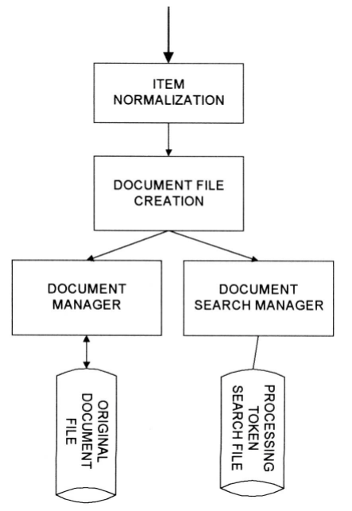
Fig: Major Data Structures
When a search is performed, the system returns references (like pointers or IDs) to items that match the search criteria. These references are then sent to the Document Manager to retrieve the actual items.

Slide 67
Stemming Algorithms
One of the first transformations often applied to data before placing it in searchable data structure is stemming.
  The original goal was to reduce the number of unique words (or tokens) that the system needed to handle.
  By stemming words to their root forms, the system could use a smaller vocabulary, which helped in reducing storage requirements and potentially sped up search processes.
Stemming can improve recall (by grouping different forms of a word together), but it might reduce precision (by matching words that are only related in their stem form but not necessarily in their specific meaning).

Slide 68
Stemming Algorithms
Although stemming simplifies the index, the system must process tokens (words) to convert them to their stems, which adds a processing step.
The trade-off between stemming and term masking is about balancing:
  Processing Overhead: Stemming adds a processing step to reduce words to their stems, but it simplifies indexing and search.
  Search Time Overhead: Term masking avoids the potential loss of precision by indexing each word variant separately, but it requires more complex and resource-intensive query processing.

Slide 69
Introduction to the Stemming Process
Conflation is the term frequently used to refer to mapping multiple morphological variant (different variation of words) to a single representation, called a stem. This term is used to describe how stemming algorithms work.
For example:
  Variants such as "connect," "connected," and "connecting" might all be conflated to the root "connect."

Slide 70
Introduction to the Stemming Process
Stem carries the meaning of the concept associated with the word and affixes (endings) introduce slight modifications to the concept.
  For example, adding "un-" to "happy" creates "unhappy," which indicates the opposite of happiness.
  Adding "-ed" to "talk" forms "talked," which changes the verb from its base form to its past tense.
Languages have specific grammatical rules that dictate how words and sentences should be structured. These rules help ensure clarity and consistency in communication.

Slide 71
Introduction to the Stemming Process
Despite having established grammatical rules, languages evolve over time based on how people use them.
This evolution can lead to changes in word usage, pronunciation, and grammar.
  Old terms may change or become outdated, and new words may be formed.
  To manage the exceptions and irregularities, particularly in computational contexts like language processing or grammar-checking software, special exception look-up tables are used.
    "Go" → "Went" (Past Tense), "Gone" (Past Participle)
    "Eat" → "Ate" (Past Tense), "Eaten" (Past Participle) -> (Instead of adhering to predictable rules, their past forms and participles must be memorized because they deviate from the regular patterns.)
  These tables list irregular forms and non-standard patterns that don’t follow the usual grammatical rules.

Slide 72
Introduction to the Stemming Process
Stemming helps improve recall by reducing different word forms (like "calculate," "calculates," "calculation," "calculations," "calculating") to a common stem ("calculat").
  This ensures that a search for any form of the word will retrieve all relevant items containing that stem.
While stemming helps with recall, it can potentially decrease precision.
Not all words should be stemmed. Proper names and acronyms (e.g., "IBM," "USA") do not share a common core concept and may not benefit from stemming.
  Stemming these words could cause confusion or loss of important information.

Slide 73
Introduction to the Stemming Process
Stemming Algorithms (common techniques):
  Affix Removal: Many stemming algorithms remove prefixes and suffixes from words. This can be done recursively to derive the final stem.
    Remove the suffix "-ing" from "running" to get "runn.” Remove the suffix "-n" from "runn" to get "run.“
  Table Lookup: Some systems use extensive data structures (like a thesaurus) to look up stems, which can be resource-intensive.
  Successor Stemming: This approach involves analyzing prefix overlaps and statistical data to determine optimal stem lengths.
    Example: "calculated," "calculates," and "calculation.
      The stemmer determines that "calculat" is an optimal stem because it captures the core meaning of the words while handling variations in prefixes and suffixes.

Slide 74
Porter Stemming Algorithm
The Porter Algorithm applies a series of rules to transform words into their stem forms.
These rules are designed to handle common suffixes and prefixes in English.
Some examples of rules are:
The measure, m, of a stem is a function of sequences of vowels (a, e, i, o, u, y) followed by a consonant. If V is a sequence of vowels and C is a sequence of consonants, then m is:
  C(VC)^{m}V
    where the initial C and final V are optional and m is the number VC repeats.

Slide 75
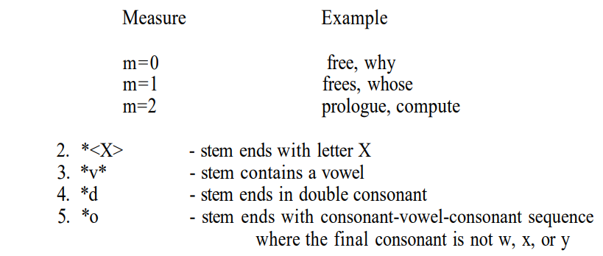
Porter Stemming Algorithm

Slide 76
Dictionary Look-Up Stemmers
Using a dictionary look-up mechanism is one way to find a stem instead than only using algorithms. (alternative to algorithm-based stemming ).
Dictionary look-up techniques use pre-made lists of words and their stemmed versions to increase the precision and accuracy of search results.
This method addresses anomalies and exceptions that algorithms could overlook, enabling a more sophisticated and regulated stemming process.

Slide 77
Dictionary Look-Up Stemmers
The system first applies simple algorithmic rules to reduce words to their base forms. For example, it might remove common suffixes like "-ing" or "-ed" to find the root.
After applying these initial rules, the resulting stem or the original term is looked up in a dictionary. This dictionary contains standard root forms and proper representations of words.
This technique has been implemented in the INQUERY and RetrievalWare systems.
  The INQUERY system uses a stemming technique called Kstem

Slide 78
Dictionary Look-Up Stemmers
Kstem is a morphological analyzer designed to reduce words to their root forms while avoiding conflation of words with different meanings.
It tries to avoid collapsing words with different meanings into the same root
  Kstem correctly identifies "memorial" and "memorize" as distinct terms and avoids collapsing them into a single root, ensuring accurate retrieval based on meaning.
    “memorial” and “memorize” reduce to “memory”. But “memorial” and “memorize” are not synonyms and have very different meanings. and should not be conflated. So Final Stem for memorial is "Memorial“ instead of memory

Slide 79
Dictionary Look-Up Stemmers
Kstem requires a word to be in dictionary before it reduce one word form to another
If the dictionary contains the stemmed word, Kstem validates it and keeps it as the final root form.
If the dictionary does not contain the stemmed form, Kstem may apply additional rules or turn to a more general root form if needed.
  This turn ensures that even if a specific term is not listed, it can still be reduced to a general root form.
    ‘factorial’needs to be in the dictionary or it is stemmed to’factory’

Slide 80
Dictionary Look-Up Stemmers
Kstem uses specific lists to handle exceptions. Some words have predefined mappings or rules that bypass general stemming algorithms to ensure accuracy.
Example:
  Exceptions List: "Suites" → "Suite"
  Proper Nouns List: "Microsoft" remains "Microsoft" because it’s a proper noun and should not be stemmed.

Slide 81
Kstem Data Files
To ensure precise and controlled stemming, Kstem utilizes six major data files that define the scope and boundaries of its operation.
These files work together to ensure that the stemming process is accurate and aligned with specific linguistic principles.
Each file plays a crucial role in shaping the stemming process, contributing to the system's overall accuracy and precision.

Slide 82
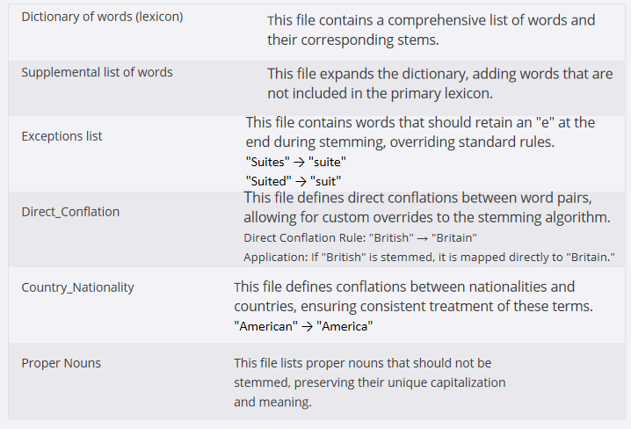
Kstem Data Files

Slide 83
Successor Stemmers
The core concept behind successor variety stemming is the successor variety of a segment.
The successor variety of a word segment is defined as the number of distinct words that share the same segment but differ in the next character, plus one for the current word.
  For instance, in the set of words {'bag', 'barn', 'bring', 'both', 'box', 'bottle'}, the successor variety of the prefix 'ba' is two, as there are two words (bag and barn) that start with 'ba' but have different third letters.

Slide 84
Successor Stemmers
Example:
  set of words {'bag', 'barn', 'bring', 'both', 'box', 'bottle'},
  Consider the word "box." Its successor variety is calculated as follows:
  The successor variety of "b" is 3, as there are three words ('bag', 'barn', 'bring', 'both', 'box', 'bottle') that start with "b" but have different second letters.
  The successor variety of "bo" is 2, as there are two words ("box", "bottle") that start with "bo" but have different third letters.
  The successor variety of "box" is 1, as there is only one word ("box") that starts with "box."

Slide 85
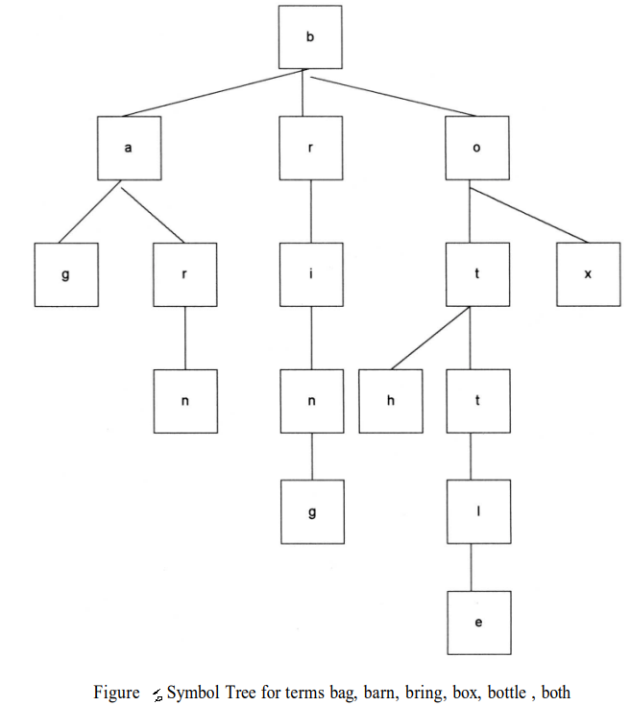
Successor Stemmers
A graphical representation of successor variety is shown in a symbol tree.
The following figure shows the symbol tree for the terms bag, barn, bring, both, box, and bottle.

Slide 86
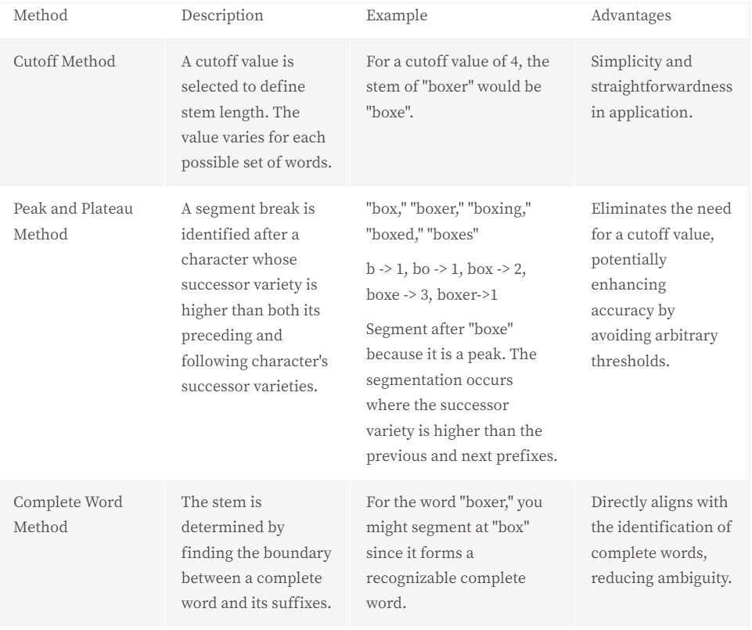
Stemming Methods Based on Successor Variety
The successor varieties of a word are used to segment a word by applying one of the following four methods : Cutoff method, Peak and Plateau, Complete word method, Entropy method

Slide 87
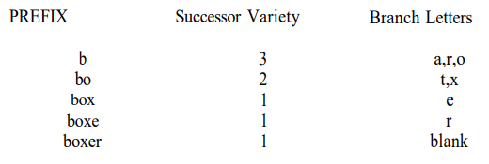
Peak and Plateau Method – Second Example:
bag, barn, bring, box, bottle , both, boxer
The peak and plateau method can not apply because the successor variety monotonically decreases

Slide 88
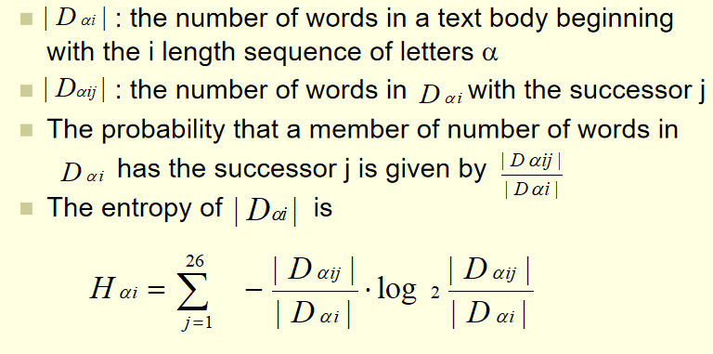
Stemming Methods Based on Successor Variety
Entropy method: uses the distribution of successor variety letters.
  Advantage: Potential for greater precision in stem identification, particularly for words with complex suffix structures

Slide 89
Entropy Method - Example
Words: "reading," "read," "reader," "reduced," "reduction“
Prefix "read":
Successor letters: 'i' (in "reading") and ‘e' (in "reader")
Probability distribution:
  p(i)=1/2 (probability of 'i')
  p(e)=1/2 (probability of ‘e')
  Entropy Calculation:
    H_{read}​=−(0.5log₂​(0.5)+0.5log₂​(0.5))=−(0.5×−1+0.5×−1)=1

Slide 90
Entropy Method - Example
Prefix "rea":
  Successor letters: 'd‘
  Probability distribution:
    p(d)=1 (probability of 'd')
    Entropy Calculation:
      H_{rea}​=−(1log2​(1))=0
    Entropy for "rea" = 0 (low variability, as all successors are 'd')
    Entropy for "read" = 1 (higher variability, as successors are 'i' and ‘e')
    The change in entropy indicates that "read" is a more informative prefix and suggests a segmentation boundary before "read" (since entropy increases after "rea" and is higher at "read").

Slide 91
Successor Stemmers
After a word has been segmented, the segment to be used as the stem must be selected.
Hafer and Weiss used the following rule:
if (first segment occurs in <= 12 words in database)
  first segment is stem
else
  second segment is stem
Example:
  Suppose we have the following words in our database:
  Words: "computation," "compute," "computer," "computers," "computing," "compete," "competition," "compliant," "compile," "complex," "component," "composed“

Slide 92
Example cont….
Let’s say we apply a stemming algorithm to the word "computing" and segment it into:
  First Segment: "comput"
  Second Segment: "ing"
Now, we need to apply Hafer and Weiss’s rule to choose the appropriate stem.
Count how many times each segment occurs in the database:
First Segment ("comput"):
  Occurs in: "computation," "compute," "computer," "computers," "computing," "component"
  Total occurrences: 6 times
Second Segment ("ing"):
  Occurs in: "computing," "competing," "complying" (assuming some other words that end with "ing" in the database)
  Total occurrences: 3 times
  The first segment "comput" occurs 6 times (which is <= 12).
  The second segment "ing" occurs 3 times (also <= 12).
Since the first segment "comput" occurs in fewer than or equal to 12 words in the database, we use it as the stem according to Hafer and Weiss’s rule.

Slide 93
Inverted File Structure
The most common data structure used in both DBMS and IRS is Inverted File Structure.
Key Points of the "Inversion":
  Word-Centric: The focus is on the words (or tokens) instead of the documents themselves.
  Efficient Searching: By storing which documents contain each word, it allows for quick retrieval of documents based on search terms.
  Logical Organization: The inversion allows for easy logical operations (like AND, OR) on sets of documents based on their content.
    It minimizes secondary storage access when multiple search terms are applied across the total database.

Slide 94
Inverted File Structure
All commercial and most academic systems use inversion as the searchable data structure
Inverted file structures are composed of three basic files:
  Document file: Contains the actual documents, each assigned a unique numerical identifier.
  Inversion lists (sometimes called posting files): For each unique word, there’s an inversion list that details the document identifiers where that word appears. This structure allows efficient querying, as it focuses on the words rather than the documents.
  Dictionary: A sorted list of unique words in the system, linking each word to its corresponding inversion list. This facilitates quick access to the inversion lists during searches.

Slide 95
Inverted File Structure
The name “inverted file” comes from its underlying methodology of storing an inversion of documents:
  Inversion of document from the perspective that, for each word, a list of documents in which the word is found in is stored (inversion list for that word)

Slide 96
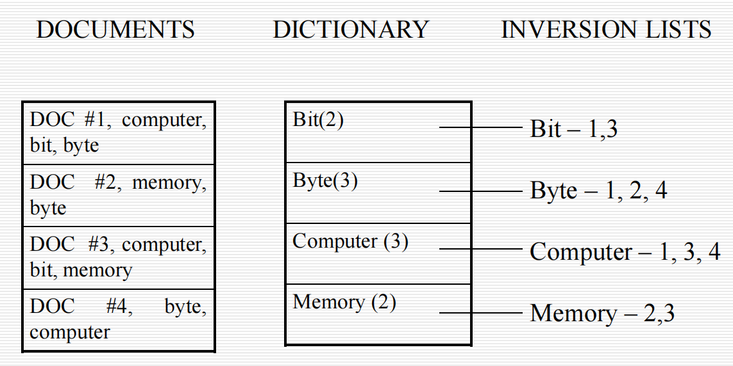
Fig 1: Inverted File Structure

Slide 97
Inverted File Structure
The inversion list structure can be further optimized for improved efficiency and precision
One optimization technique involves partitioning the dictionary by zone
Ex: There could be a dictionary and set of inversion lists for the “Abstract” zone in an item and another dictionary and set of inversion lists for the “Main body” zone.
  This allows for targeted searches within specific zones, reducing the search scope and improving performance.
  This increases the overhead when a user wants to search the complete item versus restricting the search to a specific zone.

Slide 98
Inverted File Structure
To support proximity searches, contiguous word phrases, and term weighting algorithms, the inversion list stores all occurrences of a word along with their corresponding positions within the document.
This allows for the identification of words appearing close together and the calculation of term weights based on their frequency and importance.
  Ex: If the word “bit” was the tenth, twelfth and eighteenth word in document, then inversion list would appear:
    bit – 1(10), 1(12), 1(18)

Slide 99
Inverted File Structure
Words with unique characteristics, such as dates and numbers, are often stored in separate dictionaries to facilitate optimized internal representation and manipulation.
This allows for efficient handling of date ranges and numerical operations, enhancing the search capabilities for these specific word types.
  Date Dictionary: Stores dates, enabling efficient date range searches.
  Number Dictionary: Stores numbers, allowing for optimized numerical operations.

Slide 100
Inverted File Structure
When a search is performed (query is executed):
  the system retrieves the inversion lists for the specified terms
  Logical operations (AND, OR, NOT) are applied to the retrieved inversion lists.
    If a user searches for "bit AND computer":
      The system retrieves the inversion lists for "bit" and "computer.“
      It performs an AND operation between the two lists, resulting in a final hit list of document identifiers that contain both terms.
  A final hit list of documents (result produced after processing a search query) satisfying the query is generated.

Slide 101
Inverted File Structure
Instead of using a dictionary to point to inversion lists, B-trees can be employed as an alternative storage mechanism.
The inversion lists can be stored at the leaf level of the B-tree or referenced by pointers in higher-level nodes.

Slide 102
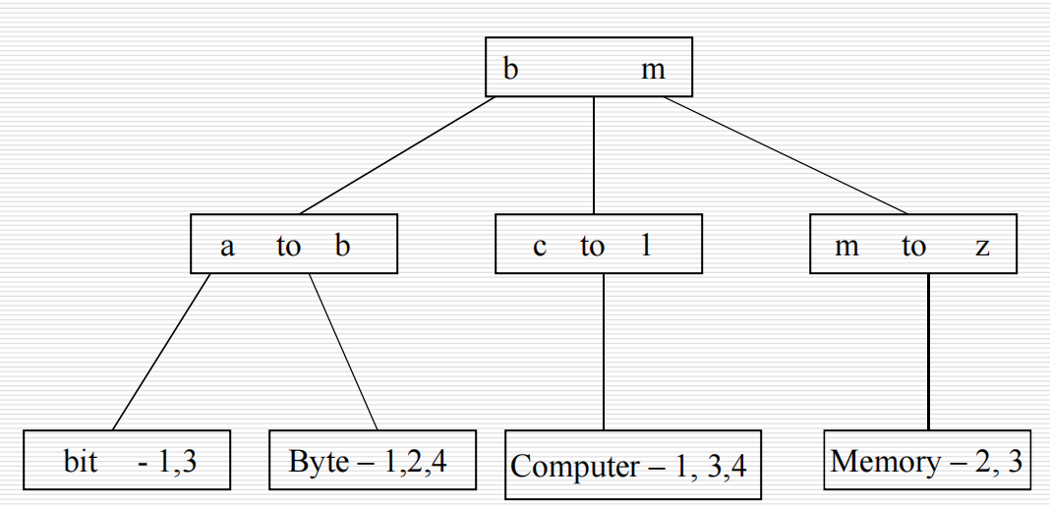
Inverted File Structure
The following figure shows how the words in figure 1 would appear
Fig: B-tree inversion lists

Slide 103
Inverted File Structure
A B-tree of order m has specific properties:
  The root node contains between 2 and 2m keys.
  All other internal nodes have between m and 2m keys
  All keys are stored in sorted order, which allows for efficient searching.
  Leaves are at the same level or differ by at most one level, ensuring balanced access times.

Slide 104
Inverted File Structure
In many information systems, once documents are created, they are rarely modified. This allows systems to:
  Grow document files and inversion lists until reaching a maximum size, after which a new structure is started.
  Each of these databases of document file, dictionary, inversion lists is archives and made available for user’s query
    Archive older databases, which can be beneficial for queries focused on more recent information.

Slide 105
Inverted File Structure
Inversion list file structures are well suited to store concepts and their relationships.
Inverted file structures optimize search performance by:
  minimization of data flow in resolving a query

Slide 106
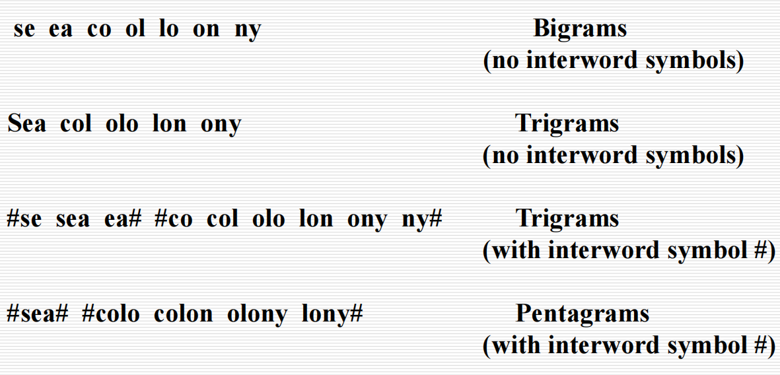
N-Gram Data Structure
N-grams are contiguous sequences of "n" characters (or symbols) taken from a string of text
Examples of bigrams, trigrams and pentagrams are given below for the word phrase “sea colony”

Slide 107
N-Gram Data Structure
Stemming reduces words to their base or root form (e.g., "running" to "run"). It focuses on semantic meaning whereas,
N-Grams do not consider the meaning of words; they simply analyze fixed-length character sequences.

Slide 108
N-Gram Data Structure
The searchable data structure is transformed into overlapping n-grams, which are then used to create the searchable database.
For example, the phrase "sea colony" would be broken down into bigrams, trigrams, and pentagrams as shown in previous figure.
The symbol # is used to represent the interword symbol, which can be any of a set of symbols like blank, period, semicolon, colon, etc.
Each n-gram becomes a separate processing token and is searchable.
It is possible that the same n-gram can be created multiple times from a single word.

Slide 109
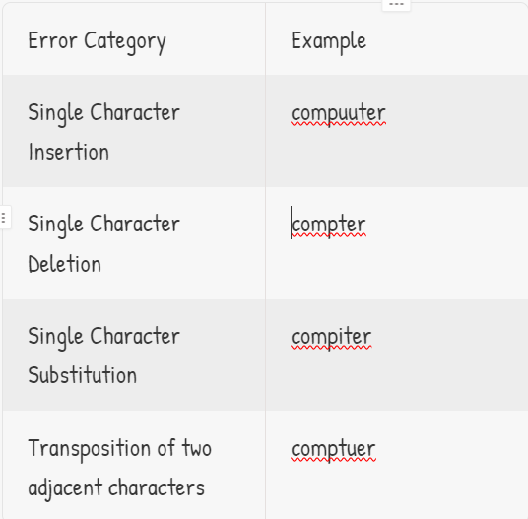
N-Gram Data Structure
Another major use of n-grams is in spelling error detection and correction.
Damerau specified four categories of spelling errors

Slide 110
N-Gram Data Structure
Using classification scheme, zamora showed trigram analysis provided a feasible data structure for identifying misspellings and transposed characters.
In information Retrieval, trigrams have been used for text compression and to manipulate the length of index terms .
Advantages of N-Grams:
  They treat input as continuous data and provide a finite number of searchable tokens.
  N-grams allow statistical assessments of word usage, aiding in tasks like language identification.
Disadvantages of N-Grams:
  False Positives: Since n-grams ignore semantics, they can yield misleading results (e.g., matching "retain detail" to "retail" due to shared trigrams).
  Increased Data Size: Using n-grams increases the number of processing tokens, which can expand data structures like inversion lists significantly.

Slide 111
N-Gram Data Structure
The advantage of n-grams is that they place a finite limit on the number of searchable tokens:
  MaxSeg_{n} = ( λ)^{n}
    λ: This represents the size of the alphabet or the number of unique symbols (including letters, punctuation, spaces, etc.) that can be used in the n-grams.
    n: This is the length of the n-grams (the number of characters in each n-gram).

Slide 112
N-Gram Data Structure
Example:
Suppose we have a simple alphabet consisting of just 3 symbols: A, B, and C.
  Here, λ=3.
Let’s consider bigrams (2-character n-grams), so n=2.
Maximum Unique N-Grams:
  MaxSeg_{n}​=λ^{n}:
  MaxSeg₂​=3²=9
  This means the maximum number of unique bigrams we can generate is 9.
    AA,AB,AC,BA,BB,BC,CA,CB, CC

Slide 113
N-Gram Data Structure
The choice of "n" affects performance.
Studies suggest that trigrams (n=3) balance information richness and data structure size effectively.
Longer n-grams reduce false positives but may not provide significant advantages over full words.
There is no semantic meaning in a particular n-gram since it is a fragment of processing token and may not represent a concept.
Thus n-grams are a poor representation of concepts and their relationships.

Slide 114
PAT Data Structure
PAT trees, also known as Patricia trees (Practical algorithm to retrieve information coded in Alphanumeric) , which are specialized data structures used for efficiently storing and retrieving text data.
In creation of PAT trees each position in the input string is the anchor point for a sub-string that starts at that point and includes all new text up to the end of the input.
  Example:
    Input String: Let’s say we have the input string:
    "CAT“
    Anchor Points: Each character in the string serves as an anchor point for creating substrings:
    Starting from the first character 'C':
      Substring: "CAT"
    Starting from the second character 'A':
      Substring: "AT“
    Starting from the third character 'T':
      Substring: "T"
Notes:
(

Slide 115
PAT Data Structure
All substrings generated from these anchor points are unique, which allows for efficient searching and indexing.
A substring can start at any point in the text and can be uniquely indexed by its starting location and length.
Example:
  From "HELLO", we can create the following substrings starting from each character:
    Starting from 'H':Substring: "HELLO" (Starts at index 0, Length = 5)
    Starting from 'E':Substring: "ELLO" (Starts at index 1, Length = 4)
    If all strings are to the end of the input, only the starting location is needed since the length is the difference from the location and the total length of the item.
  For the substring "ELLO" starting at index 1:
    Starting Position: 1
    Length: 4 (calculated as 5 - 1)

Slide 116
PAT Data Structure
Sistrings (semi-infinite strings) can conceptually extend beyond the actual input string by appending null characters (represented as #). This allows searches that consider possible continuations beyond the given text.
Example:
  For "CAT":
    Starting from 'C': "CAT###“
    Starting from 'A': "AT###“
    Starting from 'T': "T###"

Slide 117
PAT Data Structure
A PAT tree is an unbalanced binary tree used for storing and searching binary strings, called "sistrings.“
Each node branches left for a zero bit and right for a one bit. The bit position that determines the branching can be specified at each node, allowing flexibility in how the tree is structured.
Key values (the actual strings) are stored at the leaf nodes. For an input of size "n," there are typically "n" leaf nodes and "n-1" higher-level nodes.

Slide 118
PAT Data Structure
If the binary representations of “h” is (100), “o” is (110), “m” is (001) and “e” is (101) then the word “home” produces the input 100110001101.....Using the sistrings

Slide 119
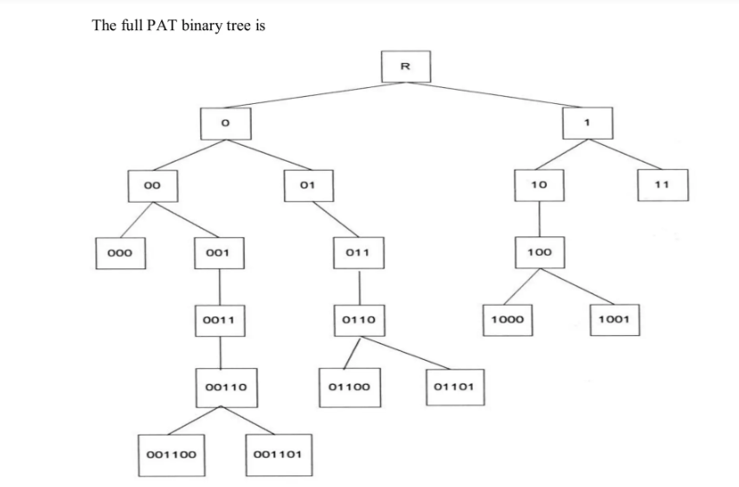
PAT Data Structure

Slide 120
PAT Data Structure
The value in the intermediate nodes (indicated by rectangles) is the number of bits to skip until the next bit to compare that causes differences between similar terms.
  A more compact version of the tree can use "skip values" at intermediate nodes, indicating how many bits to skip before the next comparison. This saves space but requires careful matching against search terms.

Slide 121
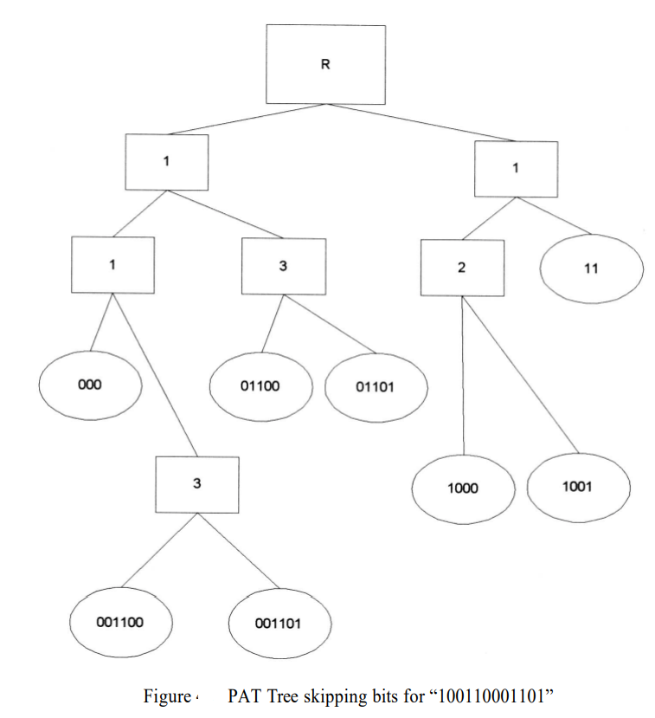
PAT Data Structure
Complete Binary Tree | Compressed Tree
Represents every bit of the sistring. | Stores skip values in intermediate nodes.
Requires more memory but is easier to understand. | Saves space but requires additional comparisons during searches.

Slide 122
PAT Data Structure
Limitations of PAT Trees
  PAT trees struggle with fuzzy searches, where slight variations in the search term are allowed. This is due to the large number of sub-trees that could potentially match a fuzzy term.
  PAT trees are not designed to store more abstract concepts or relationships between data items. They are primarily focused on string manipulation.

Slide 123
PAT Data Structure
Applications of PAT Trees
  PAT trees are used for indexing large amounts of text, allowing for fast retrieval of specific words, phrases, or patterns.
  PAT trees can enhance database search capabilities by efficiently indexing string-based fields, facilitating rapid retrieval of matching records.
  PAT trees can be used to analyze code, identifying patterns, dependencies, and potential issues within the codebase.

Slide 124
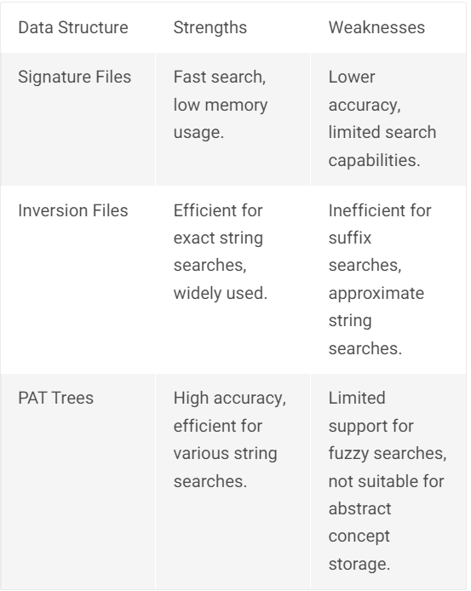
PAT Data Structure
Comparison with Other Data Structures

Slide 125
Signature File Structure
The primary goal of a signature file structure is to efficiently filter out irrelevant items in response to a query, allowing for quicker searches within a database.
It aims to minimize the number of comparisons needed by providing a fast initial test to eliminate non-matching items.
The core principle behind signature file structure is to represent the text of items in a highly compressed form, enabling rapid elimination of non-relevant items.
This compressed representation is achieved through a process called superimposed coding, which involves mapping words into fixed-length codes.

Slide 126
Signature File Structure
Because file structure is highly compressed and unordered, it requires significantly less space than an inverted file structure.
New items can be added to the end of the structure easily without needing extensive updates, which is beneficial since deletions are rarely performed in databases.
Signature File search involves a linear scan of the compressed signatures, which means the response time is proportional to the size of the file.

Slide 127
Signature File Structure
Superimposed coding is the key to creating the signature file structure.
It involves mapping words into "word signatures," which are fixed-length codes with a specific number of bits set to "1.“
The bit positions are determined using a hash function, ensuring a unique representation for each word.
The word signatures are ORed together to create the signature of an item.

Slide 128
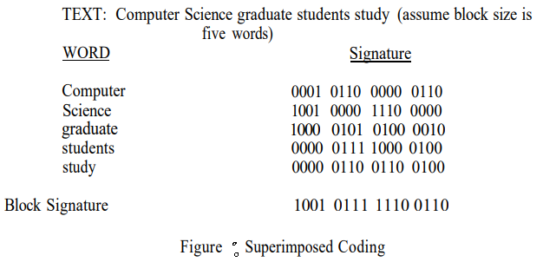
Signature File Structure
To prevent signatures from being too dense with "1"s, the number of words per item is limited, and items are divided into blocks.
In the following figure the block size is set at five words, the code length is 16 bits and the number of bits that are allowed to be “1” for each word is five.

Slide 129
Signature File Structure
When a query is made, the words from the query are also converted into signatures.
The search involves checking which signatures match the query signatures using template matching.
A key design (structure's design) objective in signature file systems is to balance the size of the data structure with the density of the final signatures.
  Longer signatures decrease collision probability in hashing, while shorter ones might lead to false hits (incorrectly matching a word).

Slide 130
Signature File Structure
Search of the signature matrix requires O(N) search time.
To reduce the search time the signature matrix is partitioned horizontally.
This involves dividing the matrix into smaller sections, allowing for faster searching by focusing on specific regions.
Storing the signature matrix by columns (inverted file structure) enhances search efficiency by only focusing on relevant columns based on query hashing
  Vertical partitioning can optimize storage space by grouping similar signatures together.

Slide 131
Signature File Structure
Applications of Signature Files
  Signature files are effective for storing and retrieving information in databases, particularly for large datasets.
  Signature files are well-suited for WORM devices (Write once read many), where data is written once and cannot be modified.
  Signature files can be used in parallel processing systems to distribute the search workload across multiple processors.

Slide 132
Hypertext and XML Data Structures
The rise of the Internet has transformed how we represent and access information through structures like hypertext, which differs significantly from traditional data formats.
Hypertext ("Hypertext" refers to links that connect web pages to one another) is primarily stored using HTML and XML , both of which allow for the organization and linking of information in innovative ways.
Both of these languages provide detailed descriptions for subsets of text similar to Zoning.
  These subsets can be used the same way zoning is used to increase search accuracy and improve display of hit results.

Slide 133
Definition of Hypertext Structure
The hypertext data structure is fundamental to the Internet, enabling the storage and retrieval of information in an electronic format.
  In the context of hypertext, electronic format means that content (like web pages) is created using markup languages (such as HTML or XML) and can be easily linked, modified, and retrieved over the Internet.

Slide 134
Definition of Hypertext Structure
Hypertext consists of nodes (individual items) linked by pointers (links), enabling users to navigate non-sequentially.
Each node can reference various data types, such as text, images, or videos.
  When a user accesses a node, the appropriate viewer or application—such as a web browser, image viewer, or media player—displays the content based on its file type.
    For example:
      Text nodes might be displayed as part of a web page.
      Image nodes would be shown in an image viewer or embedded directly in a web page.
      Video nodes require a media player or browser capability to stream or play the video.

Slide 135
Definition of Hypertext Structure
HTML structures web documents using tags (e.g., <title>, <strong>), with hyperlinks defined by <a href=... ….#NAME> tags that point to other resources, either on the same server or elsewhere on the Internet.
  <a> tag defines a hyperlink, which is used to link from one page to another.
  “href” is the hypertext reference containing either a file name if the referenced item is on this node or an address (URL) and a file name if it is on the other node.
    href attribute indicates the link's destination.
  “#NAME” defines a destination point other than the top of the item to go to

Slide 136
Definition of Hypertext Structure
Hypertext offers a flexible organizational model, as users can choose to follow links or continue reading sequentially.
This non-linear structure encourages exploration and can present multiple pathways through related information.
However, it also poses challenges in navigation, particularly in larger information spaces.

Slide 137
Hypertext History
The term "hypertext" was coined by Ted Nelson in 1965.
Early systems like the Hypertext Editing System and HyperCard laid the groundwork for modern hypertext applications, which gained popularity in the 1990s with the advent of the World Wide Web and the Mosaic browser, making hypertext accessible to a wider audience.

Slide 138
XML
XML (eXtensible Markup Language) emerged as a flexible standard for structuring web data, balancing the simplicity of HTML with the complexity of SGML.
It allows users to create custom tag.
  Enables users to provide more detailed and meaningful descriptions of their data.
  Hypertext links for XML are being defined in the Xlink (XML Linking Language) and Xpoint ( XML Pointer Language) specifications.

Slide 139
Hidden Markov Models
Hidden Markov Models (HMM) have been applied for the last 20 years to solving problems in speech recognition and to a lesser extent in the areas locating named entities, optical character recognition and topic identification.
More recently HMMs have been applied more generally to information retrieval search with good results.

Slide 140
Hidden Markov Models
A HMM can best be understood by first defining a discrete Markov process.
A Markov process is defined by states and the probabilities of transitioning between these states.
The easiest way to understand a Markov process is by an example.
In a basic example, consider a stock market with three states:
  State 1 (S1): Market decreased
  State 2 (S2): Market unchanged
  State 3 (S3): Market increased

Slide 141
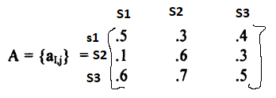
Hidden Markov Models
Transitions between these states can be modeled using a state transition matrix that defines the probabilities of moving from one state to another. (this assumes you can go from any state to any other state):
Given that the market fell on one day (State 1), the matrix suggests that the probability of the market not changing the next day is .1. (probability of change of state from S1 to S2 is .1)

Slide 142
Hidden Markov Models
This then allows questions such as the probability that the market will increase for the next 4 days then fall.
  This would be equivalent to the sequence of SEQ = {S3, S3, S3, S3, S1}.
  we can calculate the probability of this specific sequence of states using the transition probabilities from the matrix A.
  Initial State:
    Assuming P(S3)=1 initially, meaning the market starts by increasing.

Slide 143
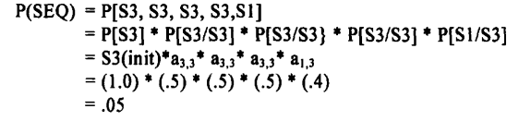
Hidden Markov Models
The probability of the sequence can be calculated as:
This means the probability of the market increasing for four days and then falling is approximately .05.

Slide 144
Hidden Markov Models
Markov models rely on the assumption that the future state depends only on the current state, which can be too simplistic for complex problems, such as interpreting spoken language.
Incorporating a probability function associated with the states leads to the development of Hidden Markov Models (HMMs).
  In traditional Markov models, each state is deterministic, meaning the next state is fixed based on the current state. HMMs allow for a probabilistic approach, where each state can lead to various possible outputs with certain probabilities.

Slide 145
Hidden Markov Models
Hidden Markov Models add flexibility by allowing the states themselves to be hidden (not directly observable). Instead, we observe output generated from these hidden states.
The model consists of two stochastic (probabilistic) processes:
  Hidden Process: The actual state of the system, which we cannot observe directly.
  Observable Process: The outputs or observations we can measure, which are related to the hidden states.

Slide 146

Hidden Markov Models
An HMM is formally defined by several components:
  S = { S0, , …, Sn-1} as a finite set of states where s0 always denotes the initial state. Typically the states are interconnected such that any state can be reached from any other state.
  V = { v0, , …, vm-1} is a finite set of output symbols. This will correspond to the physical output from the system being modeled.
  A = S x S a transition probability matrix where a_{i,j} represents the probability of transitioning from state i to state j such that for all i = 0, ... , n -1. Every value in the matrix is a positive value between 0 and 1. For the case where every state can be reached from every other state every value in the matrix will be non-zero.

Slide 147

Hidden Markov Models
  Output Probability Matrix (B): This defines the likelihood of producing a particular output from a given state. Each entry b_{j,k} specifies the probability of output k given state j. for all j = 0, ..., n-l.
  Initial State Distribution (θ): The probabilities of starting in each state.

Slide 148
Hidden Markov Models
HMM can be used for Dual Purposes:
  HMMs can generate possible sequences of outputs based on the defined model parameters. This means that, given the states and their probabilities, you can simulate or produce sequences of observable outputs.
  Conversely, if you have a specific sequence of outputs, you can use an HMM to model how that sequence might have been generated.
    This involves determining which states were likely involved in producing the observed output.

Slide 149
Hidden Markov Models
To fully define an HMM, we need specification of the states (s), the output symbols (v) and three probability measures for
  the state transitions (A),
  output probability functions (B) and
  the initial states (θ).
The distributions are frequently called A, B, and θ and the following notation is used to define the model:
  λ = (A,B,П)

Slide 150
Hidden Markov Models
One of the main tasks when using an HMM is to calculate the probability of a sequence of observed outputs given the model.
  This involves determining how likely it is that a certain sequence was generated by the model parameters (transition probabilities, output probabilities, and initial state distribution).
When you have multiple competing models, the goal is to identify which model is most likely to have generated the observed outputs. This involves comparing the calculated probabilities of the observed sequences across different models.
To select the states or models, an optimality criterion is often used.
  This could involve maximizing the likelihood of the observed data or minimizing some form of error. Various algorithms exist to perform this selection.

Slide 151
Hidden Markov Models
Once a model is chosen, the next step is to determine which specific sequence of hidden states best explains the observed outputs. This can involve:
  Decoding Algorithms: Such as the Viterbi algorithm, which finds the most probable sequence of states given the observed outputs.
The final issue mentioned is tuning the model parameters (denoted as λ).
  The goal is to adjust the parameters to maximize the probability of the observed output sequence given the model.
  This typically involves using a set of training data to refine the model’s parameters through methods like the Baum-Welch algorithm.

